Slide 1
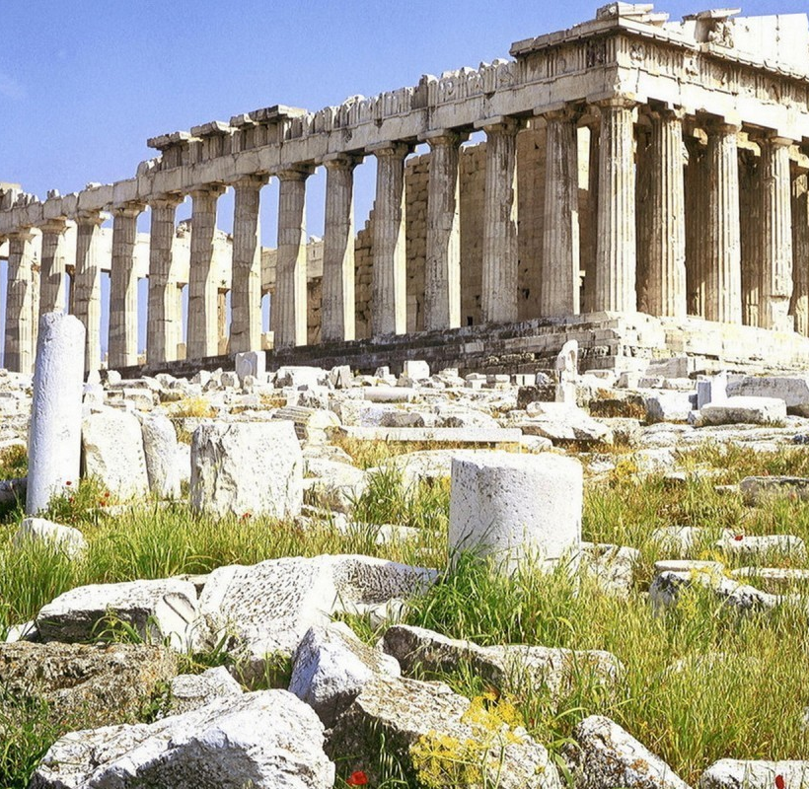
GCSE CLASSICAL CIVILISATION
YEAR 9 OPTIONS

Slide 2
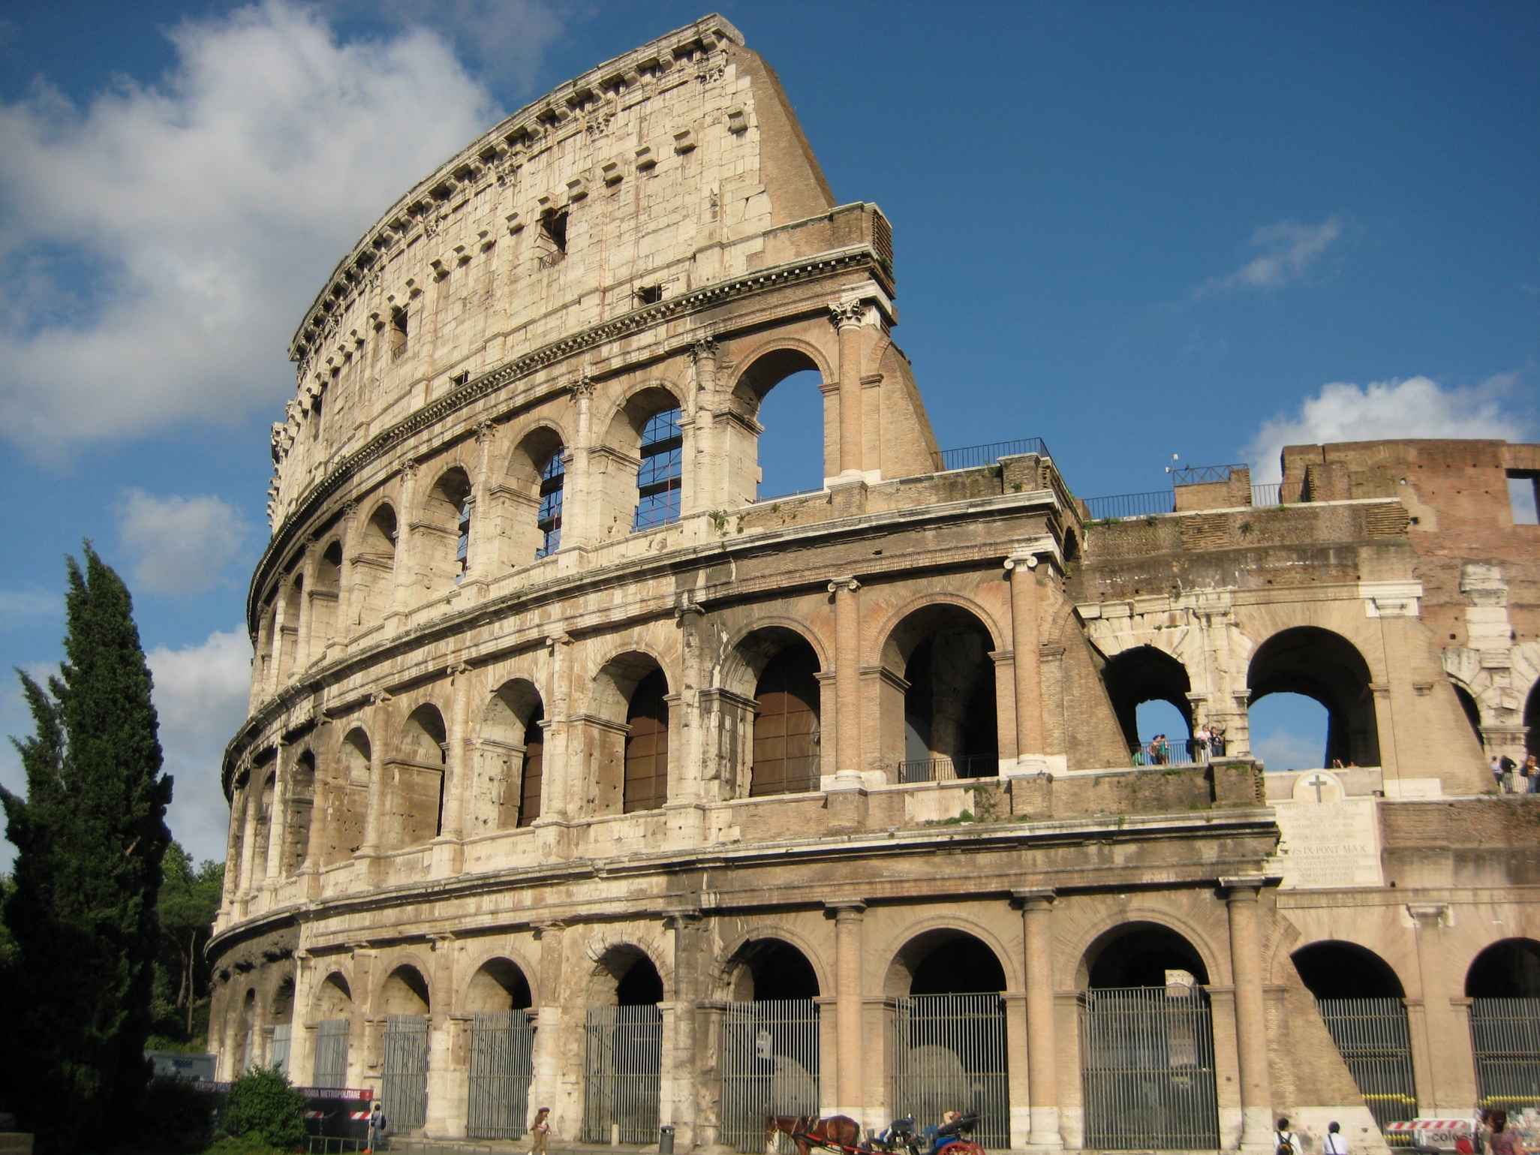
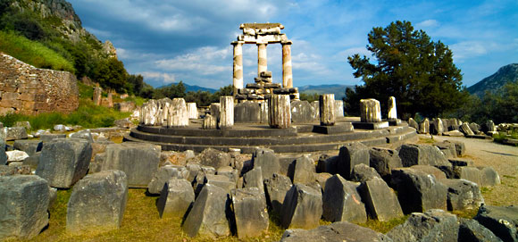
WHAT IS CLASSICAL CIVILISATION?
Classical Civilisation focuses on the ancient civilisations of Greece and Rome. It involves the study of how people lived, what they believed in and the important events that affected their lives.

Slide 3
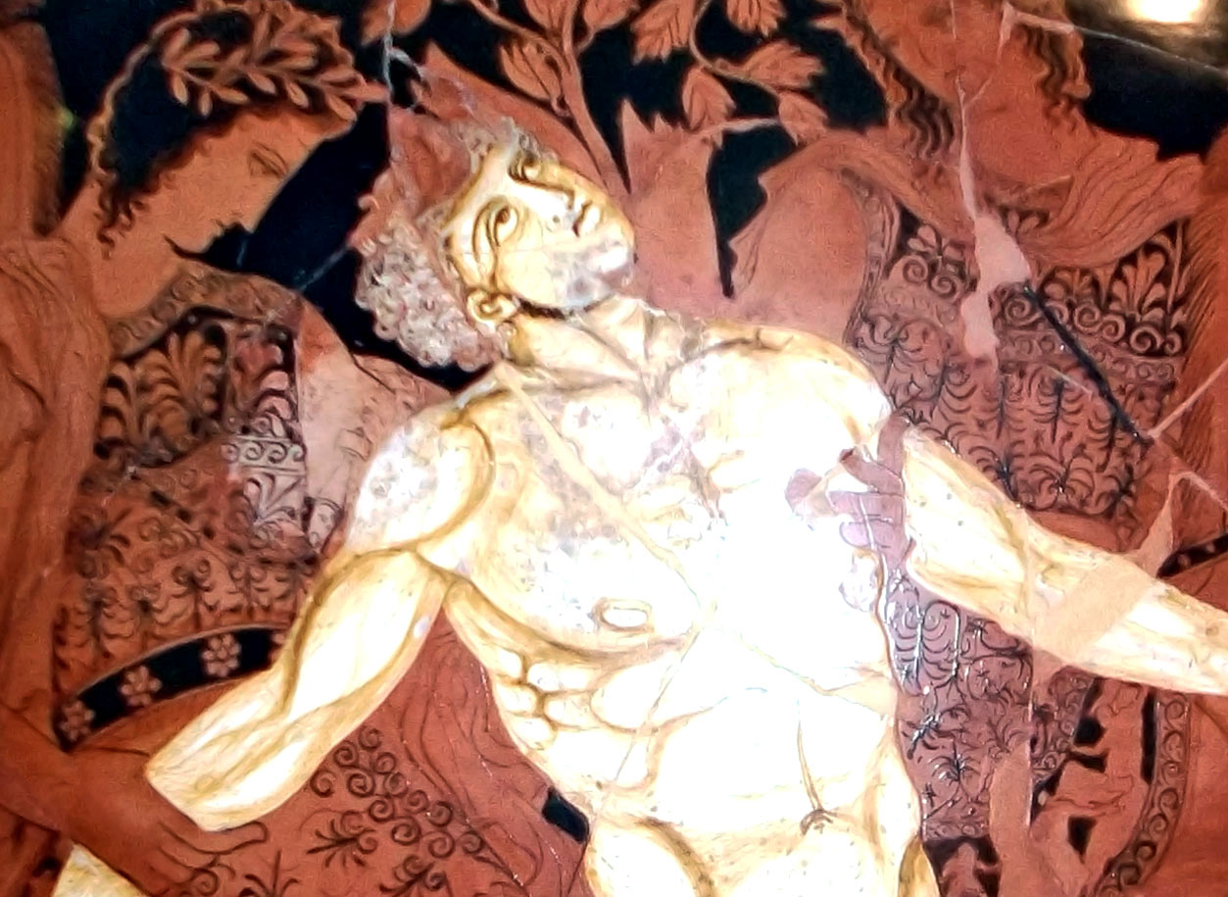
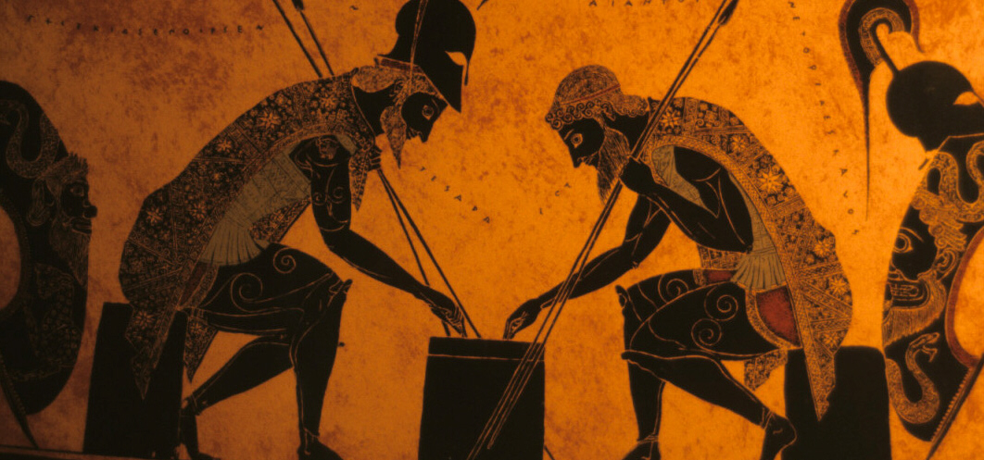
WHAT IS CLASSICAL CIVILISATION?
In this course, you will study ancient history, some of the earliest works of literature, art, ancient artefacts and archaeological sites, as well as mythology and stories involving gods and heroes.

Slide 4
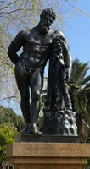
MYTHOLOGY
Stories of the Greek and Roman gods
Stories of ancient heroes
How belief in the gods affected the lives of ordinary people
How gods and heroes were worshipped
PAPER ONE

Slide 5
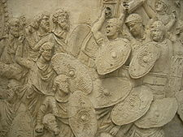
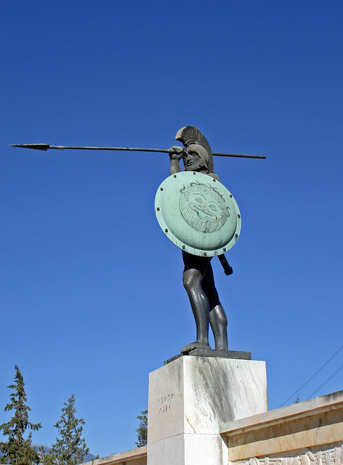
HISTORY
PAPER TWO
Sparta and Athens
The Greek and Persian Wars
The rise of Emperor Augustus
Trajan and the Dacian Wars

Slide 6
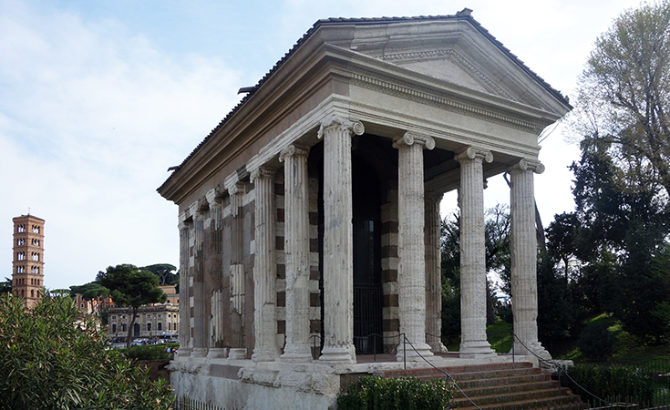
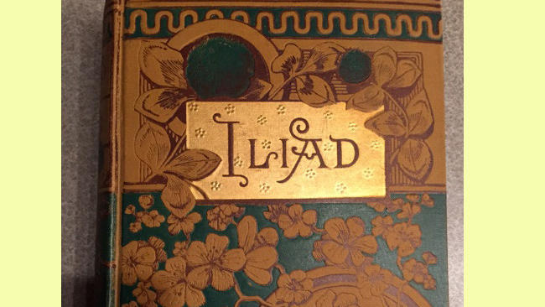
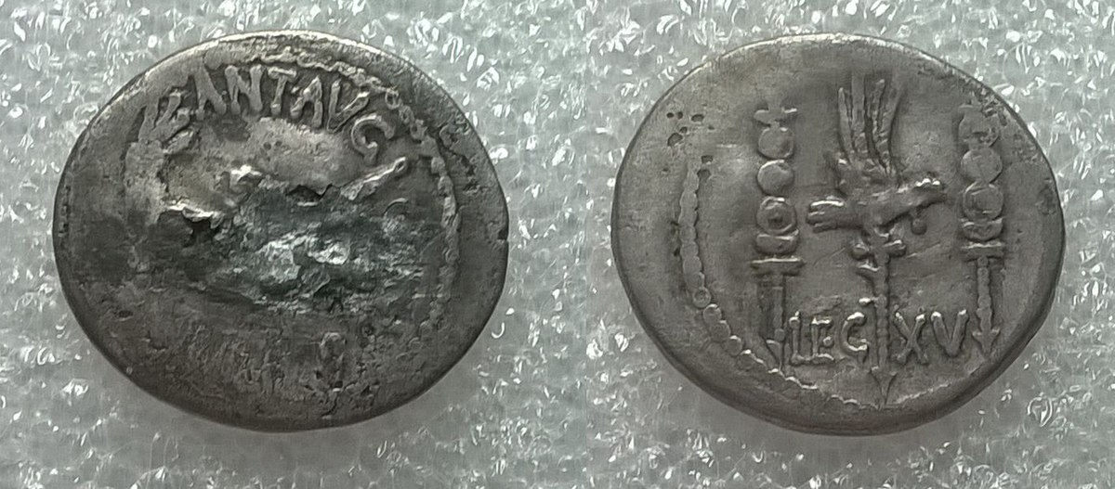
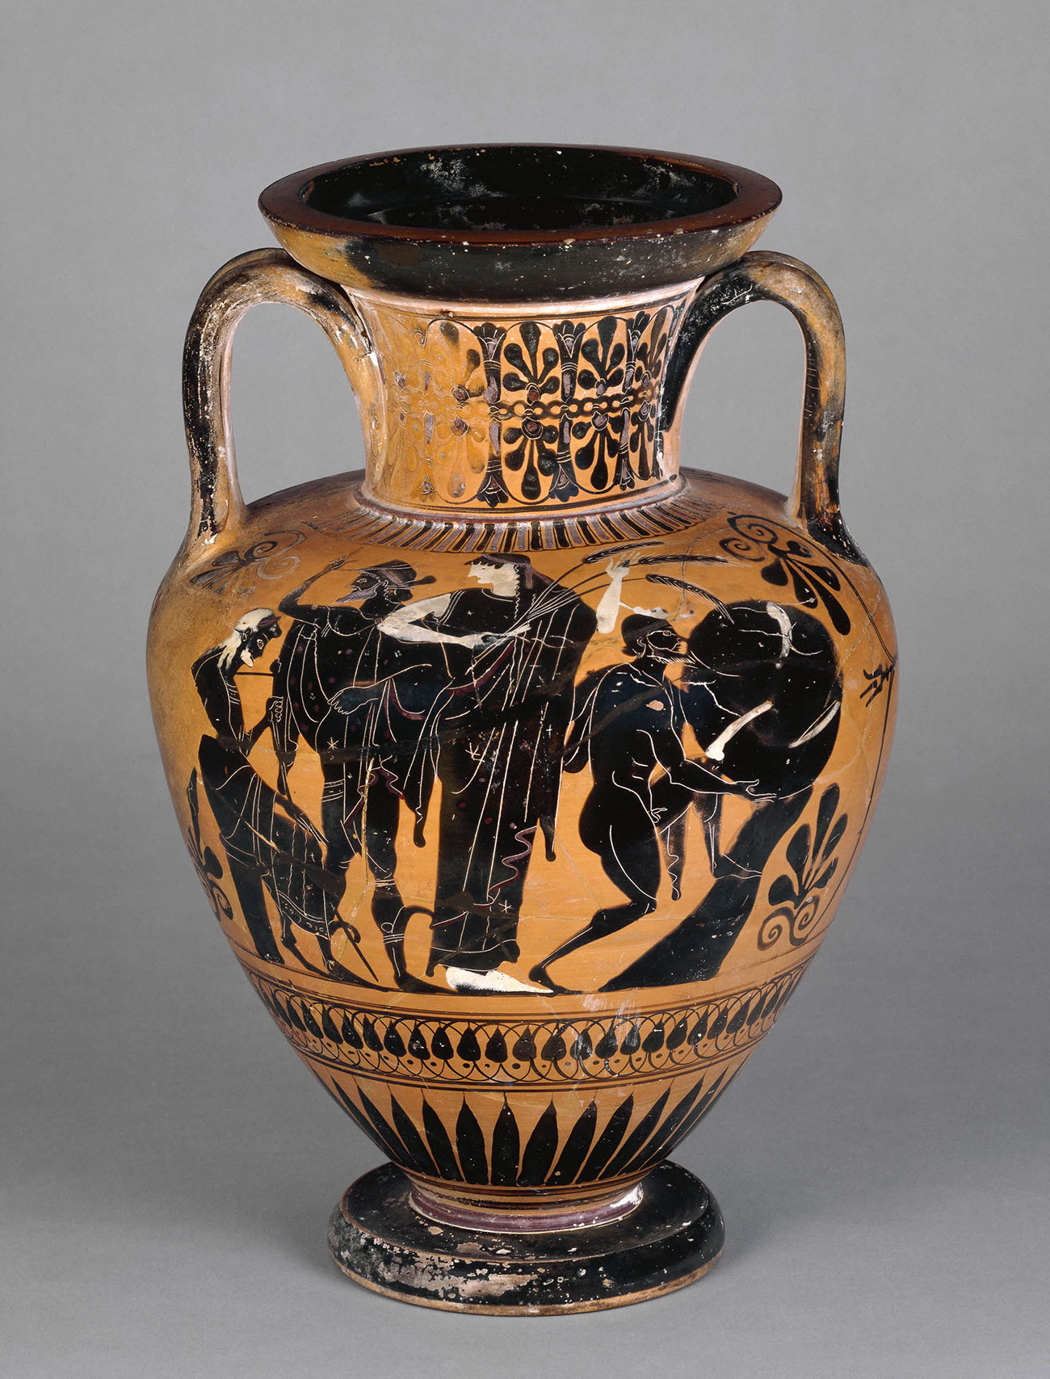
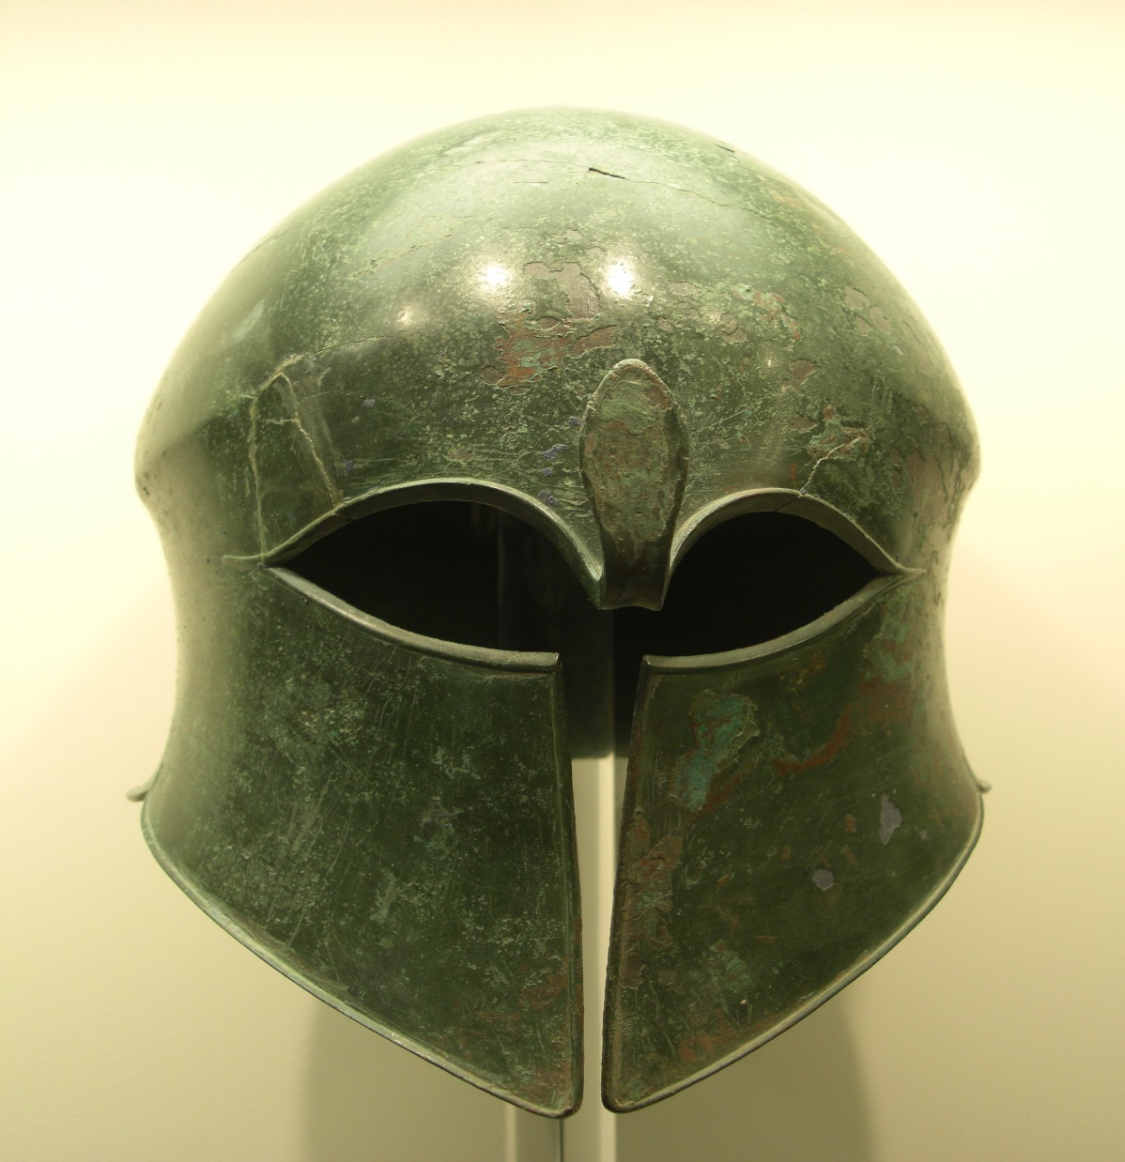
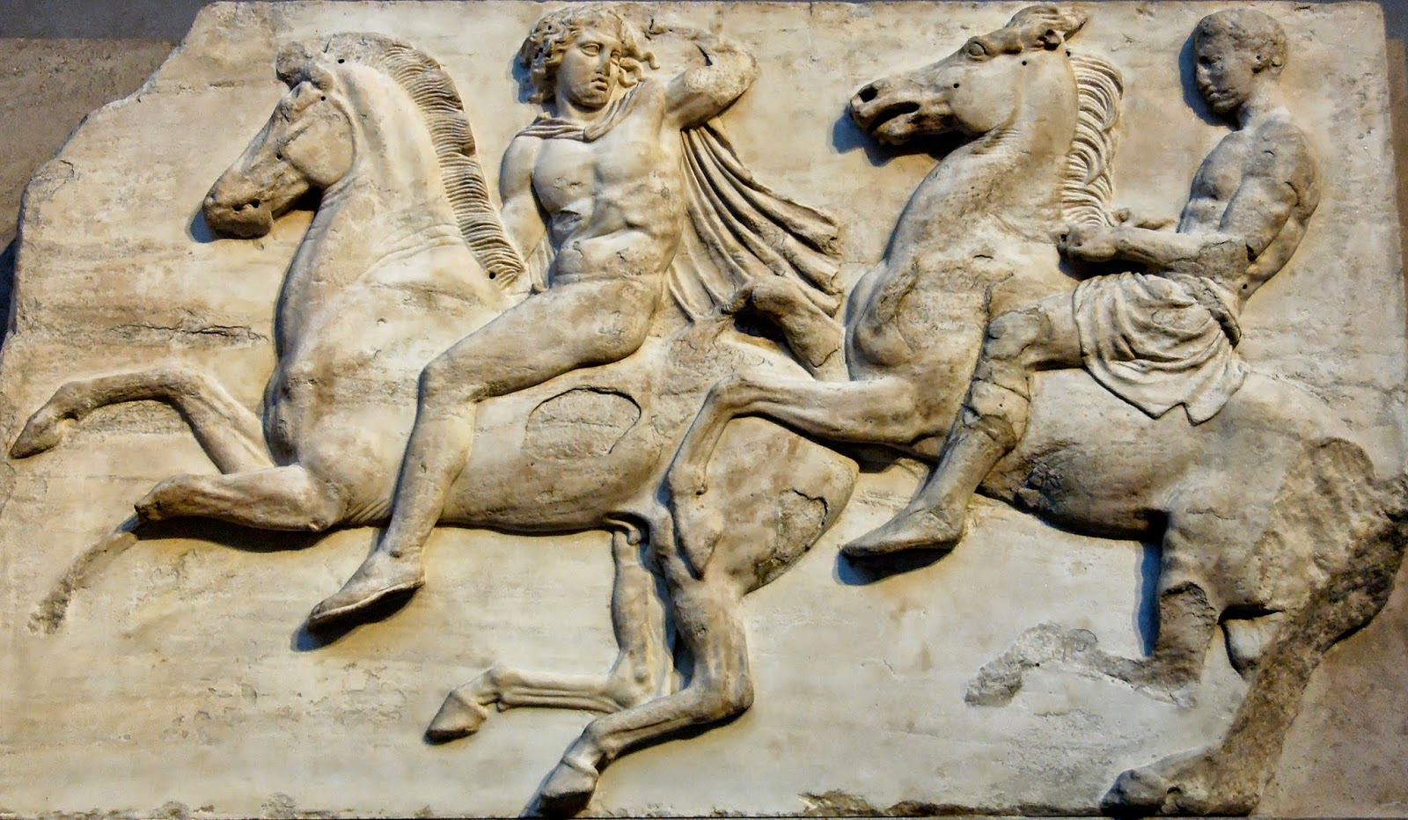

Slide 7
The course involves the study of archeological artefacts, the ruins of ancient temples and the earliest written literary works – stories that are thousands of years old.
These will help you to understand the ancient world and the issues they faced.

Slide 8
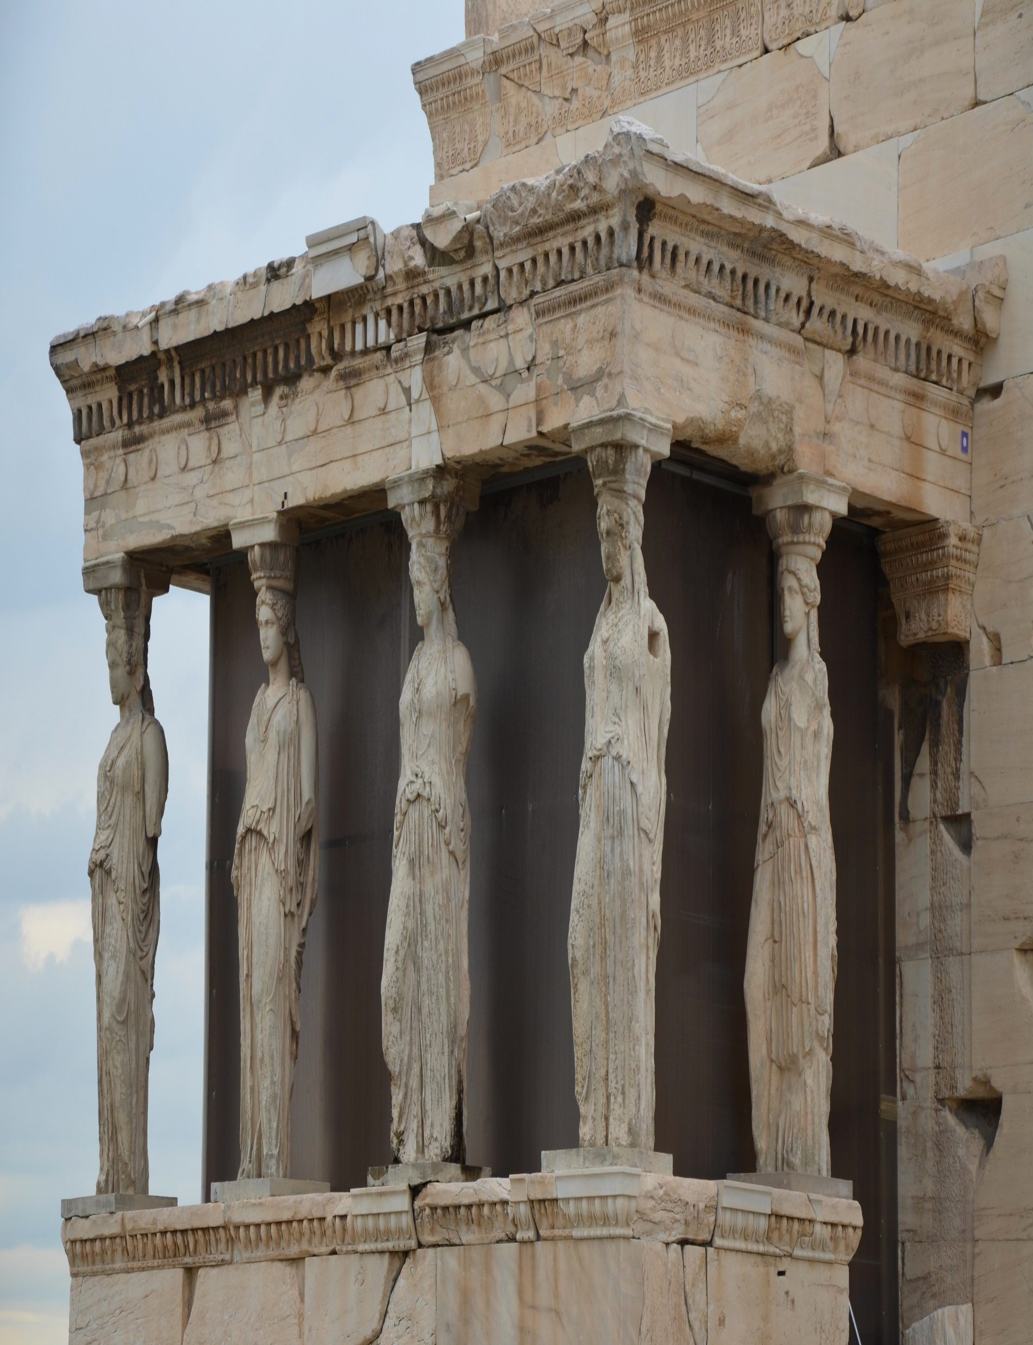
From our role in society, to the study of our beliefs and values of how we should live, Classical Civilisation involves interesting discussions about things that are still important to us today.

Slide 9
Men grappled with exactly the same issues that we do: life, death, gods, sex, love, family, children, education, money, health, status, friendship, power, patriotism, politics, law, crime, justice, empire, law.
Dr Peter Jones

Slide 10
WHAT SKILLS DO YOU NEED TO TAKE THIS COURSE?
You need to be able to analyse and reason, both orally and in writing. You also need to be able to look at evidence and draw conclusions. But, above all, you need intellectual curiosity and an enquiring mind.

Slide 11
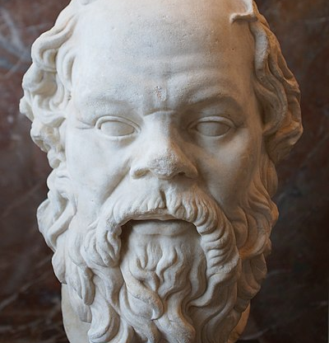
IS IT A USEFUL QUALIFICATION?
If you’re planning on going to sixth form, Classical Civilisation will prepare you for a wide range of A Level subjects.

Slide 12
IS IT A USEFUL QUALIFICATION?
A reason to consider Classical Civilisation is to invest in yourself and your future career – classics students have a reputation for being intelligent, analytical, and articulate, given the nature of their studies. They are also widely employable, and well regarded by potential employers for their broad skillset, knowledge, and logic.

Slide 13
IS IT A USEFUL QUALIFICATION?
A reason to consider Classical Civilisation is to invest in yourself and your future career – classics students have a reputation for being intelligent, analytical, and articulate, given the nature of their studies. They are also widely employable, and well regarded by potential employers for their broad skillset, knowledge, and logic.
dhalpin@corver.rmplc.co.uk

